Slide 1
Stock jump prediction using Australian Securities Exchange using high frequency trading data

Slide 2

Stock jump prediction using Australian Securities Exchange using high frequency trading data
Hua Vinh Viet Anh
Instructor: Nguyen Thanh Tuan

Slide 3
Contents
01
Introduction
02
Data preprocessing
03
Data visualization
04
Models
05
Results
06
Discussion

Slide 4

1. Introduction

Slide 5
Stock market
Stock prices move based on the balance or imbalance between demand and supply for a company's stock.
This demand and supply varies due to multiple reasons, including the emotions of people who are involved with trading.
➔ Technical analysis cannot project this balance or imbalance in demand and supply of retail investors, nor can it project what institutional investors are planning to do in the markets.
EZ money?
SELL
BUY
SELL
BUY

Slide 6
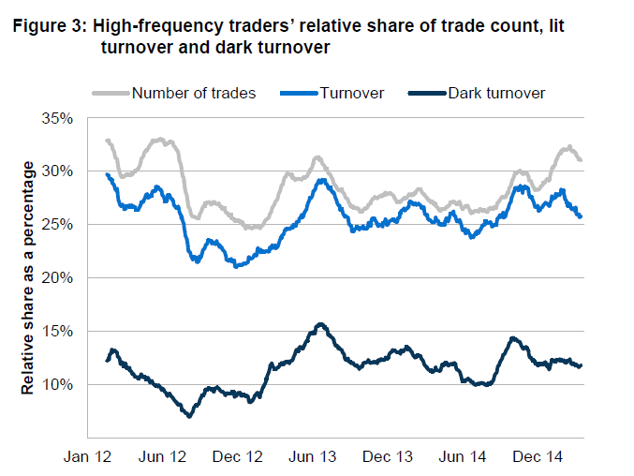
Stock and algorithm trading
Rate of algo trading in Australian Securities Exchange

Slide 7
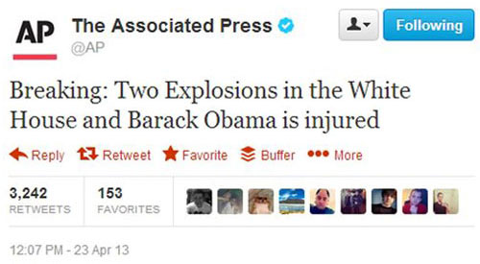
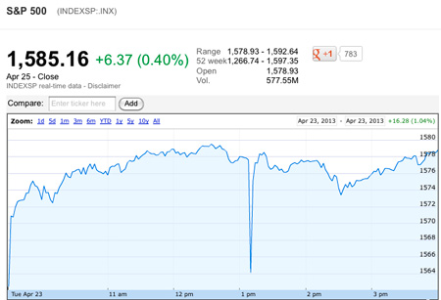
Stock and algorithm trading
Apr 2013: Fake news about Obama

Slide 8
Stock jumps
refer to large discontinuous changes in the path of stock returns
- mainly associated with:
company-specific events,
news announcements
large arbitrage hedging activities (eg. Buy future that the stock price will go down)
SELL
BUY

Slide 9
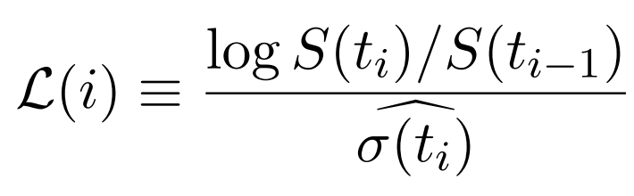
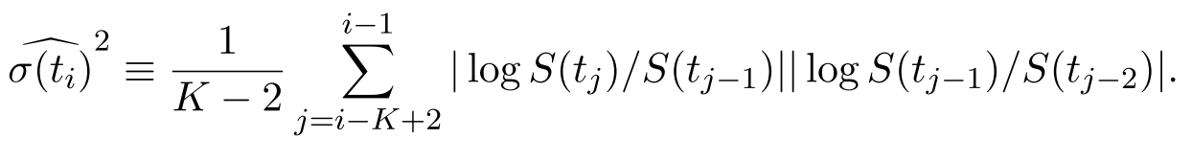
Stock jumps label
L(i) > alpha : upward jump
L(i) < -alpha: downward jump

Slide 10
Stock jumps detection applications
Risk Management
Option pricing
Asset allocation
$100.50
SELL
BUY
$203.00

Slide 11
2. Data preprocessing

Slide 12
Dataset
2 years of Tick-by-tick data of 21 ASE stocks
Aggregated into 5-min intervals
For days or interval that have no data, some features are estimated using last available data of that stock

Slide 13
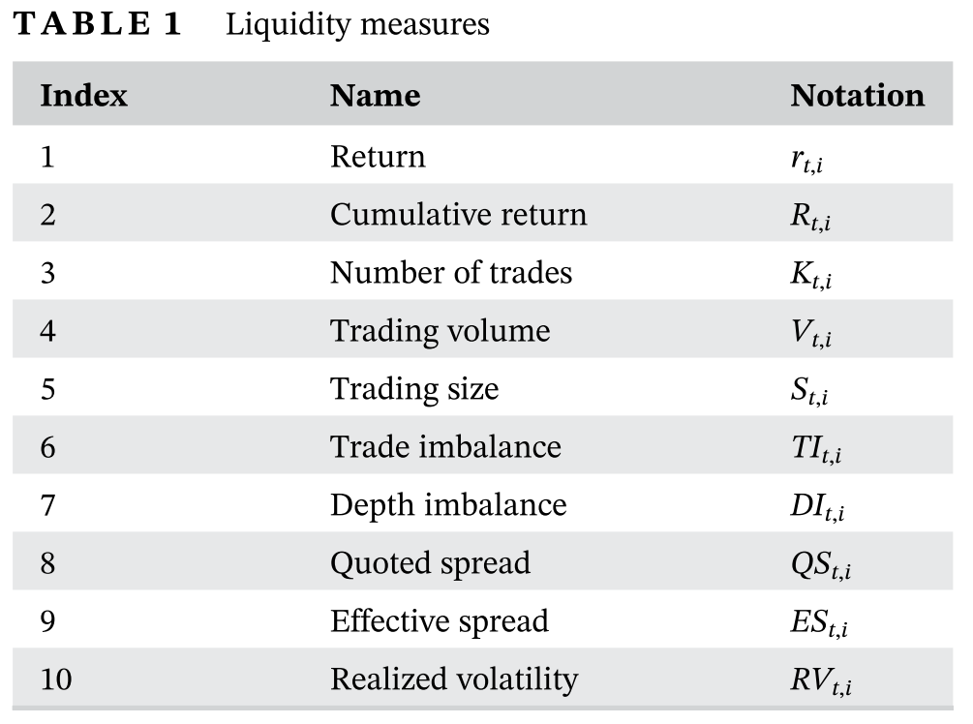
Liquidity measures
Prior studies show that liquidity measures within a prior 1-hour window might affect stock jumps
12 lagged intervals are adopted to calculate these measures
104 liquidity features

Slide 14
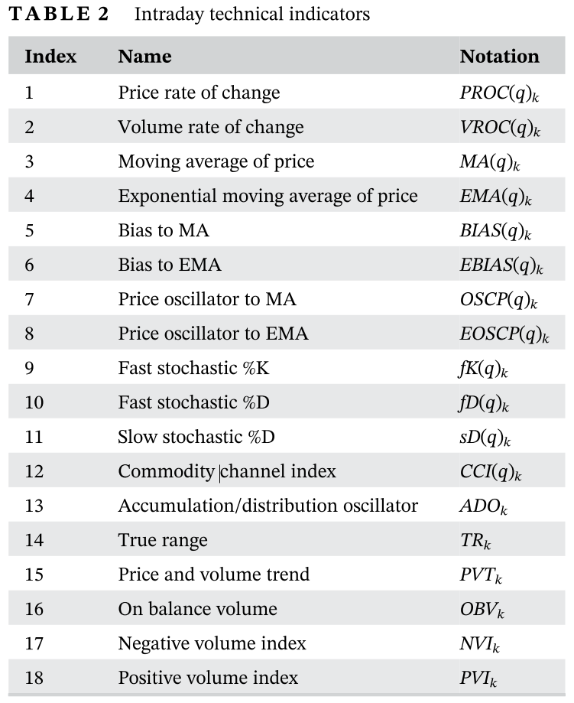
Technical indicators measures
To capture the market change within a moderately longer period,
lags of q = 5, 10, 20, 30 are used to define our intraday technical indicators
126 technical indicators features

Slide 15
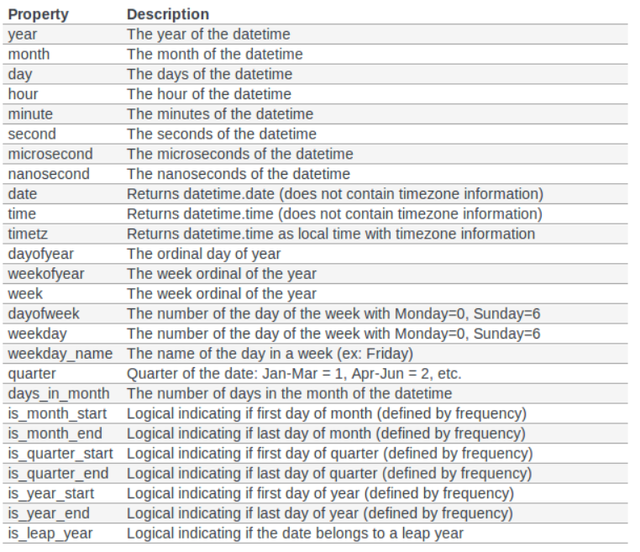
Time features
12 time features are extracted
238 total features

Slide 16
Data transforming
All 226 technical and liquidity features are then applied Min-Max Scaler and Standard Scaler.
12 time features are one-hot encoded.
Iterate through all the columns and utilize the data type to for better efficiency (~70% reduction in memory usage) .
A feature selection process was being done to select the best set of features that will be used for hyperparameters tuning and training process (lower computational cost).

Slide 17
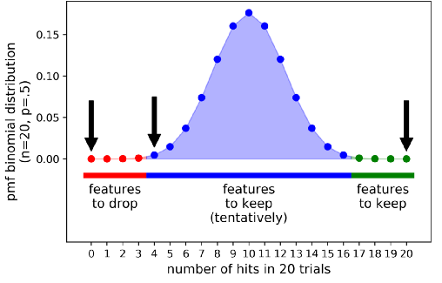
Feature selection using Boruta algorithm
238 shadow features are created by randomly shuffling each feature.
Then, a random forest fitting process is irritated for a number of times.
A feature is useful only if its average feature importance is greater than that of the best randomized feature.
➔ 56 important features detected by this algorithm are used for hyper parameter tuning process

Slide 18
2. Data visualization

Slide 19
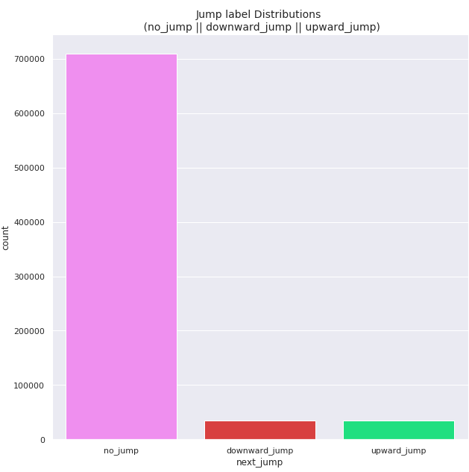
Imbalanced classes
Alpha = 5000
The dataset is highly imbalanced
This issue need to be tackled
Random oversampling, undersampling, SMOTE was being applied to our dataset.
Random undersampling method gave the best performance

Slide 20
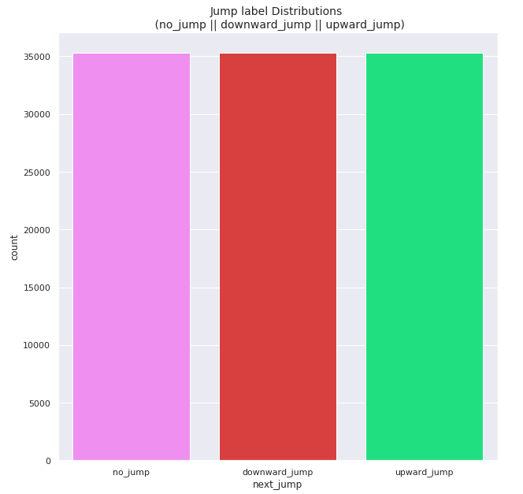
Imbalanced classes
After applying random undersampling
on ‘no_jump’ class, it look a lot better

Slide 21
Let see if our dataset interpretable using dimensionality reduction ?__?

Slide 22
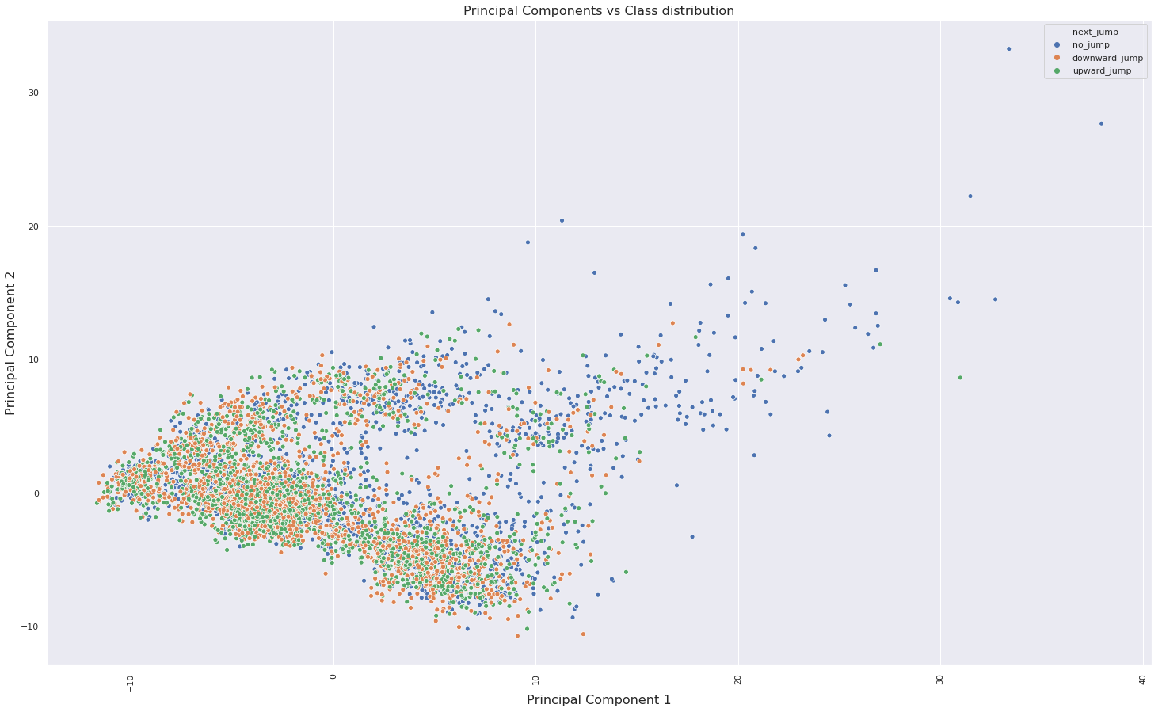
Dimensionality Reduction and Clustering:
PCA

Slide 23
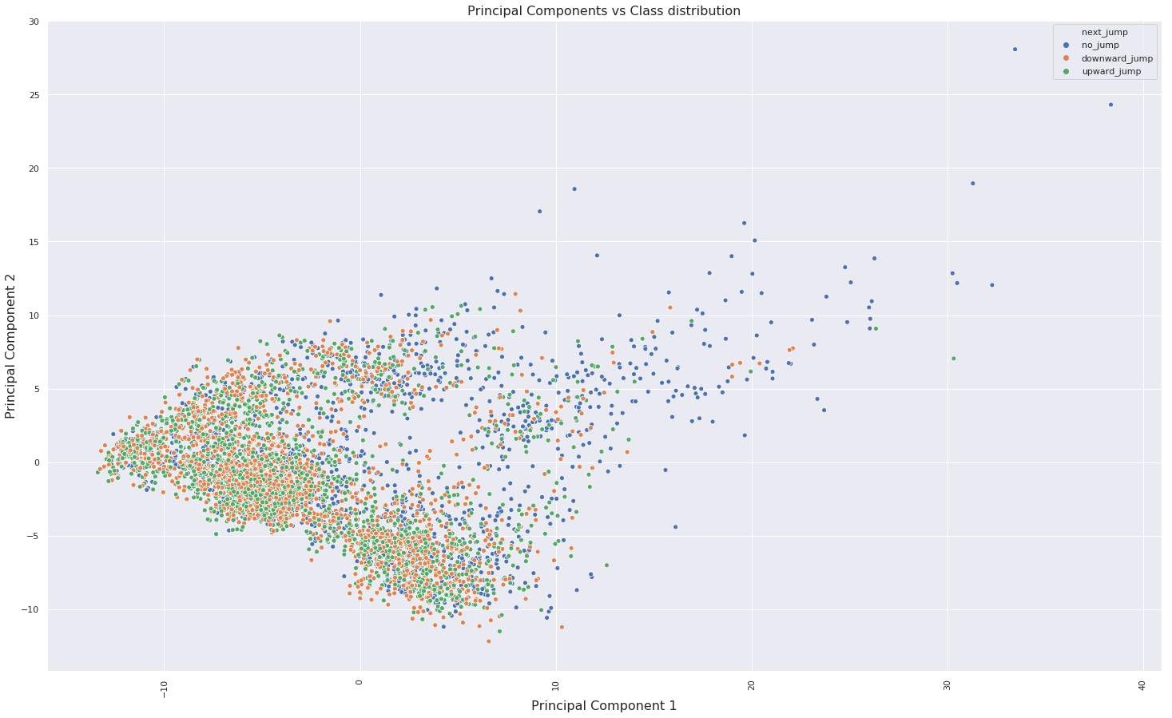
Dimensionality Reduction and Clustering:
truncatedSVD

Slide 24
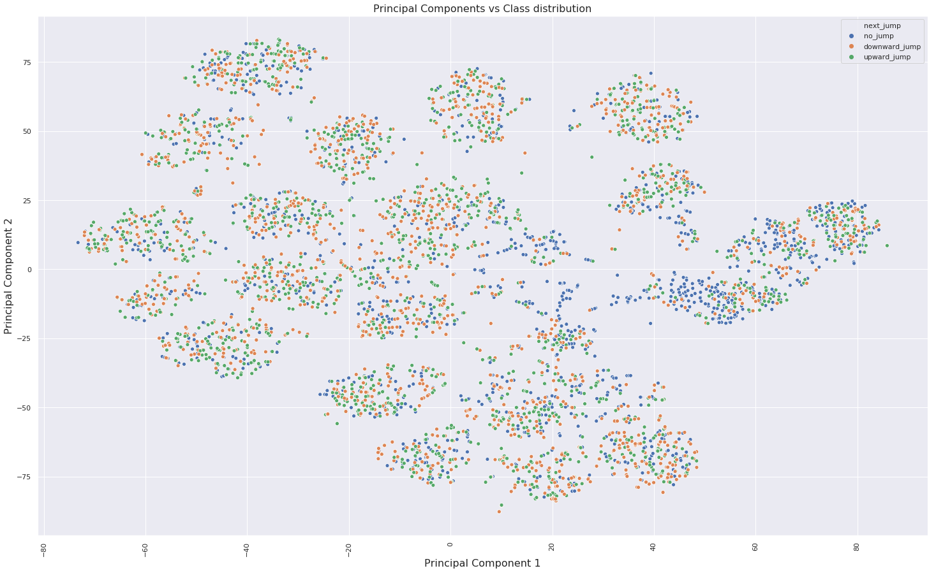
Dimensionality Reduction and Clustering:
t-SNE

Slide 25
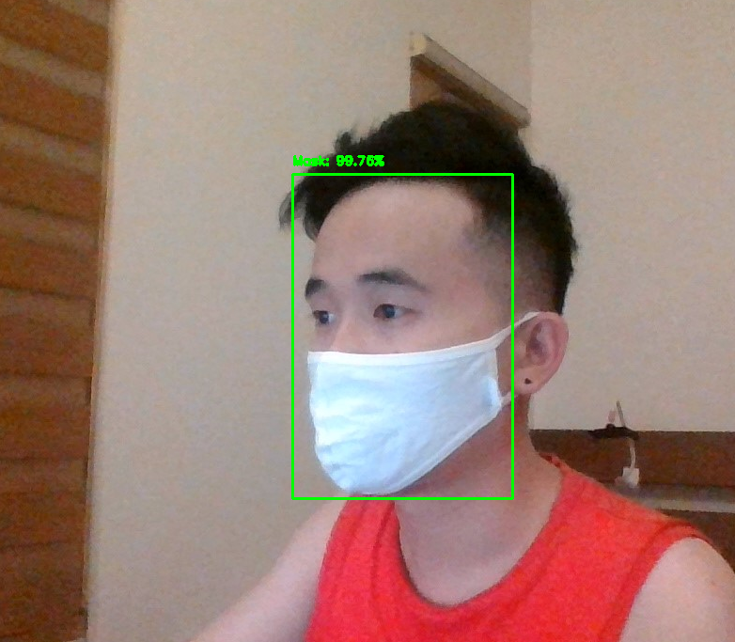
4. Predicting Models
“Không có gì là nothing,
Không thể là impossible”

Slide 26
Models
XGBoost
LightGBM
XGBoost and LightGBM are fast, computational efficient with acceptable accuracy. LightGBM is now the ‘meta’ model in Kaggle competitions for this classification task. It runs very fast, especially on CPU.
Especially in time limitation condition, these two models allow me to spending time on different important tasks such as feature engineering to better represent the real market condition, data validation and reconciliation to assure input quality for every models.
Disclaim: more complicated ML and DL models will be implemented in the future.

Slide 27
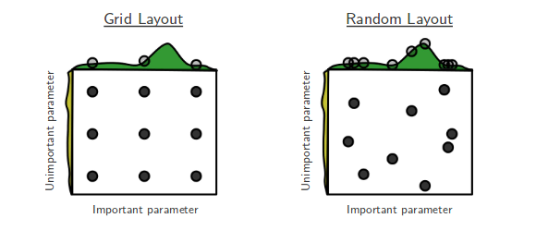
Hyperparameters tuning
using Random Search CV
RandomSearchCV and GridSearchCV are among the most simple and popular algorithms for ML model hyperparameters tuning tasks.
Random Search are widely considered better, especially when you have too many parameters to tune because: Random search has a probability of 95% of finding a combination of parameters within the 5% optima with only 60 iterations.
If the close-to-optimal region of hyperparameters occupies at least 5% of the grid surface, then random search with 60 trials will find that region with high probability.

Slide 28
5. Results
“Không có gì là nothing,
Không thể là impossible”

Slide 29
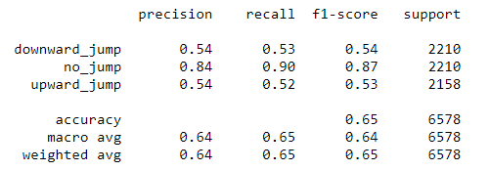
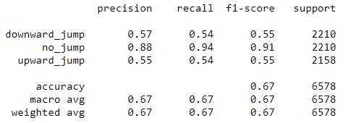
Results
XGBoost
LightGBM

Slide 30
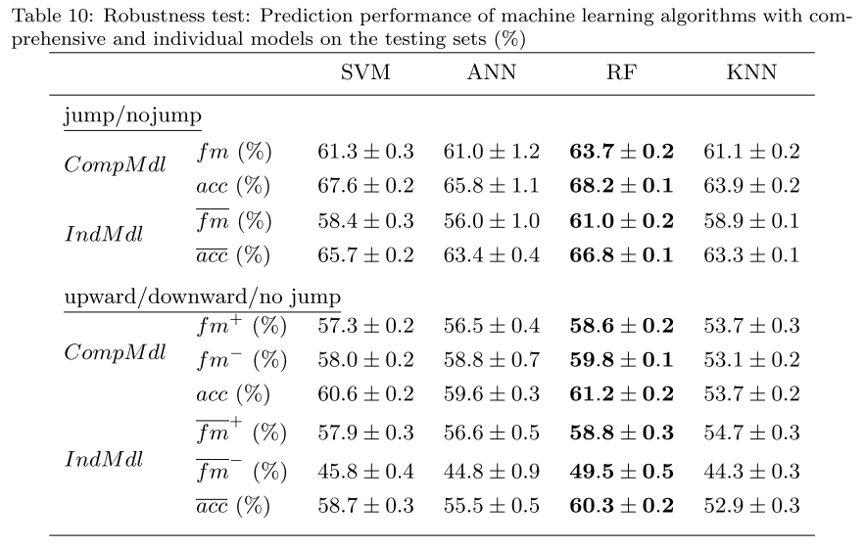
Results comparisons
Results of Kong, Zhu, Azencott (Journal of Forecasting, 2020) using 1271 stocks on the Shenzhen Stock Exchange of China

Slide 31
6. Discussion

Slide 32
Improvements
- All stocks in ASE will be added to our dataset.
- We are working on these features to put into models in the future:
Company events
Market news announcements
Sentiment analysis of social media posts of influencers or market experts
Fundamental information of companies

Slide 33
Application of the models
EZ PROFIT
IDI LOSS

Slide 34
Application of the model
Trên thực tế: no_jump nhiều hơn rất nhiều lần so với jump
➔ mô hình có 2 mặt lợi hại:
Nếu thực tế là upward và dự đoán đúng ⬄ profit
Nếu dự đoán là upward mà thực tế là no jump ⬄ loss: lỗ phí giao dịch, upward jump: thêm cả phần lỗ do giá tụt.
Nếu profit > loss thì model ok, có thể apply cho TTVN, đặc biệt là khi intraday trading có thể được thông qua trong thời gian tới.
EZ PROFIT
IDI LOSS

Slide 35

Thank You
Insert the Sub Title of Your Presentation

